Slide 1
Email Management System
Neil Rafferty BEng(hons) Software Engineering
PSG Group 6
Dr. Ian McChesney
Deadline: Monday the 5th of December 2016

Slide 2
Overview
Aims and Objectives
Competition
Useful Technologies
Viewpoints
Requirements
Risk
Strategy
Design
Schedule

Slide 3
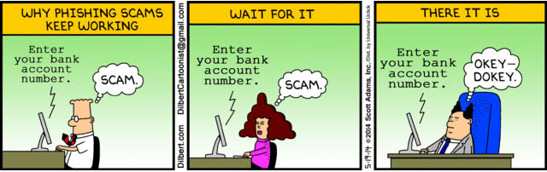
Background
Context:
Email messaging connects over 2.5 billion people world-wide (Radicati Group Inc., 2015) and still continues to be the leading method of business communication today (Radicati Group Inc., 2016).
Threats:
Third parties who obtain our email addresses can:
Spam us with marketing emails.
Spam us with dangerous phishing and malware attacks.
Build online profiles about us (sharing and selling our information).
They may even have the ability to hack into our accounts.
Notes:
There are 7 billion people in the world
Comic from:
https://www.google.co.uk/url?sa=i&rct=j&q=&esrc=s&source=images&cd=&ved=0ahUKEwiHuvPUldvQAhWBOsAKHT6FCXIQjBwIBA&url=http%3A%2F%2Femailmarketingweb.com%2Fwp-content%2Fuploads%2F2014%2F06%2Fdilbert-phishing-scam-email-comic-spam.jpg&psig=AFQjCNFd1e3q6CO0Q8osZ5DJ34gNtcrtMQ&ust=1480962577144060

Slide 4
AIMS & OBJECTIVES
This project will attempt to address these issue through the development of a email service that utilizes one email address per user.
Aim:
To create an email service that gives users more control over their contacts and contact information.
Objectives:
Develop a project requirement specification.
Create a basic client/server email service.
Alter the service to utilise multiple email addresses (per user).
Create a public board for users to report contacts for a range of offences.
Add more common email features.

Slide 5
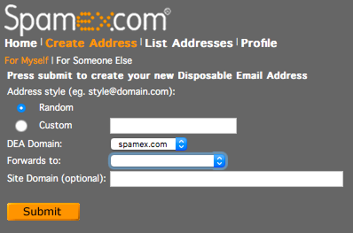
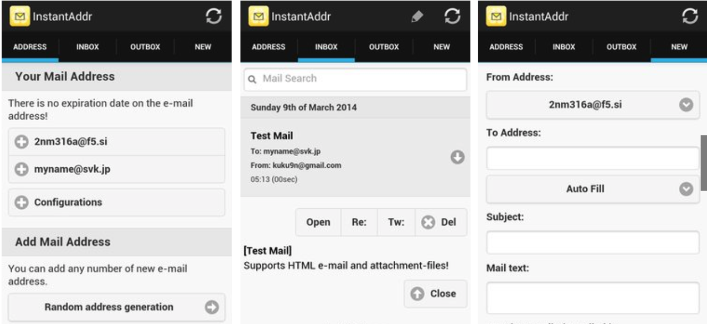
COMPETITION
Spamex:
Manages Multiple Email Addresses.
Allows Customisation of Generated Emails.
Only Forwards Emails.
Poor User Interface.
Instant Email Address:
Quickly Generates Multiple Email Addresses.
Easy Management of Email Addresses.
Intuitive User Interface.
Only works on Android Devices.
Notes:
Nearly Cried, then remembered contacts
Microsoft Clutter

Slide 6



Useful Technologies
iRedMail is a ready made email server solution that may fit the needs of this project as:
It is Open Source.
Runs on Debian.
Compatible with PostgreSQL.
Works with Antispam & Antivirus.
Can be linked to DAViCal.
DAViCal is a calendar which may be useful because:
It is Open Source.
Runs on Debian.
Compatible with PostgreSQL.
Easy to setup.
Can be linked to iRedMail.

Slide 7
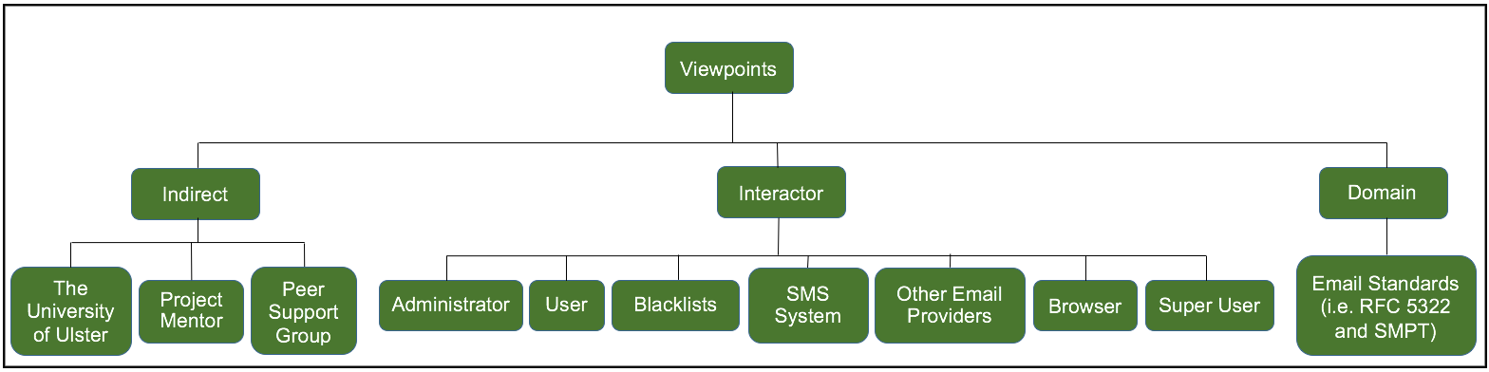
Viewpoints
Indirect:
The University of Ulster – As this us a university project, the university may have some influence over the direction and outcome.
Peer Support Group - Will offer support and guidance.
Project Mentor – The project mentor, Dr Ian McChesney, will continue to offer guidance throughout the duration of the project.
Domain:
Email Standards - Basic email standard need to be adhered too.

Slide 8
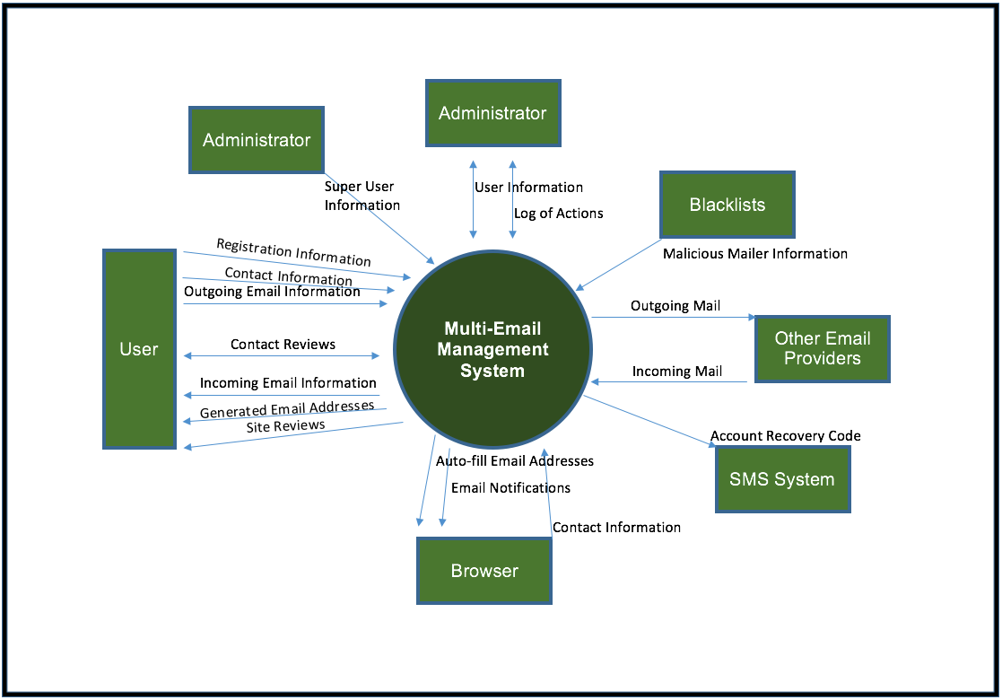
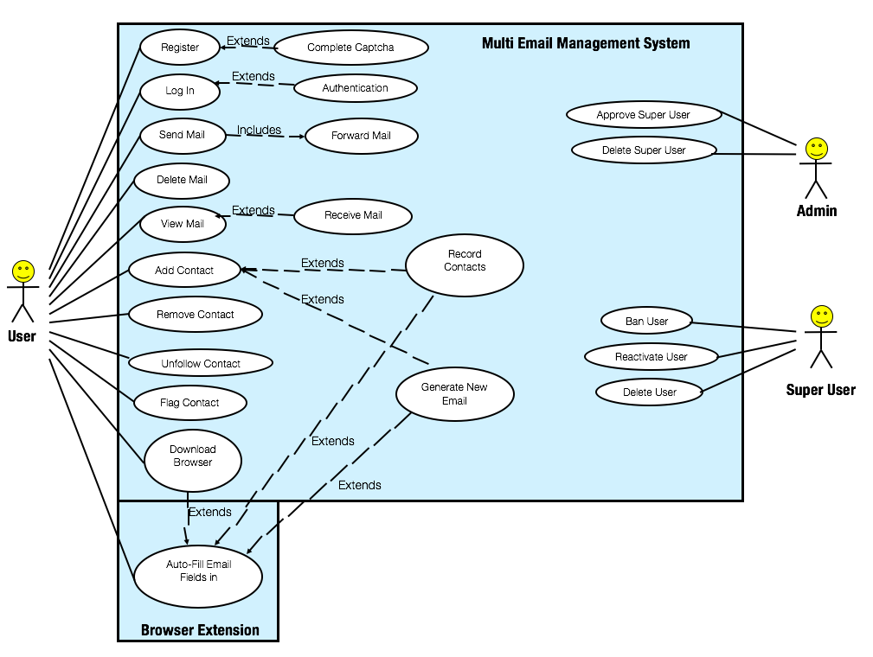
Context
Interactor:
Administrator– This person will be responsible for managing User and Super User accounts.
Super User – This person will be responsible for managing User accounts.
User – A person who uses the application for communicative purpose.
Blacklists – Online lists of malicious emailers.
SMS System – This may be used for account recovery.
Other Email Providers – Other email providers that the system will communicate with.
Browser – Some browser extension functionality may be added for a better user experience.

Slide 9
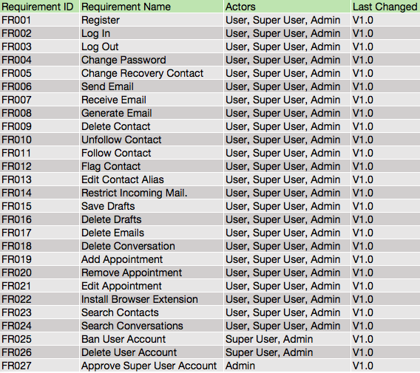
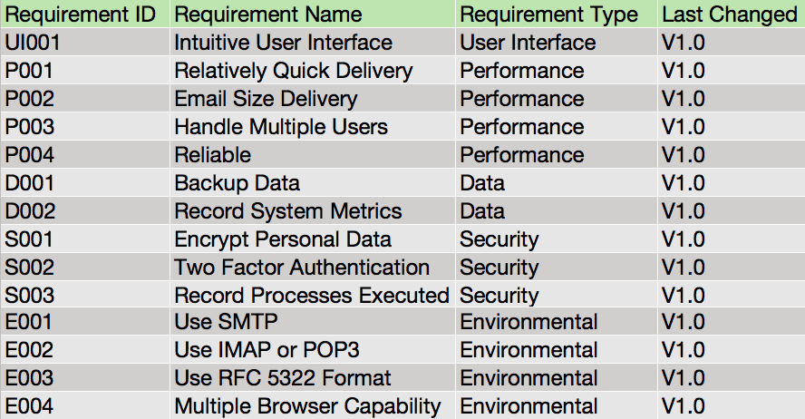
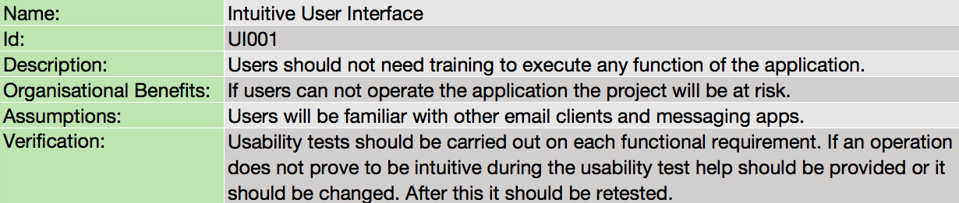
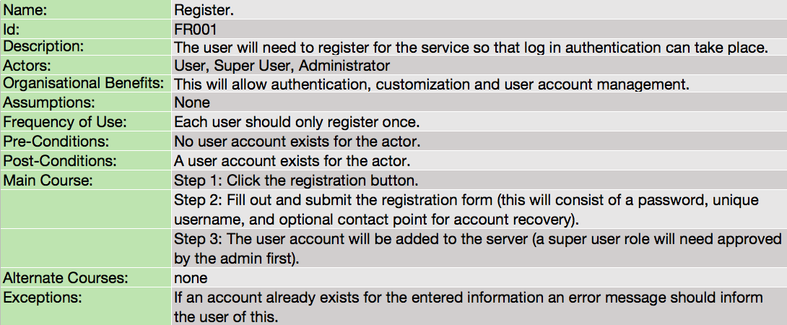
Requirements
Functional
Non-Functional

Slide 10
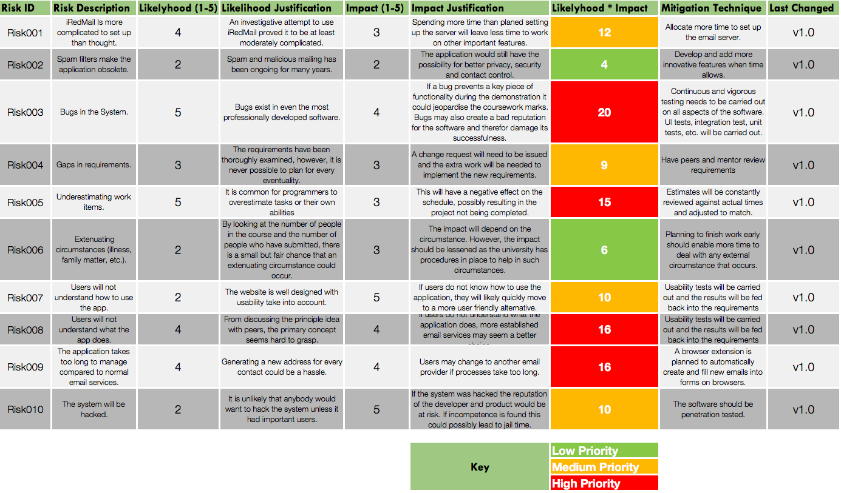
RISK

Slide 11
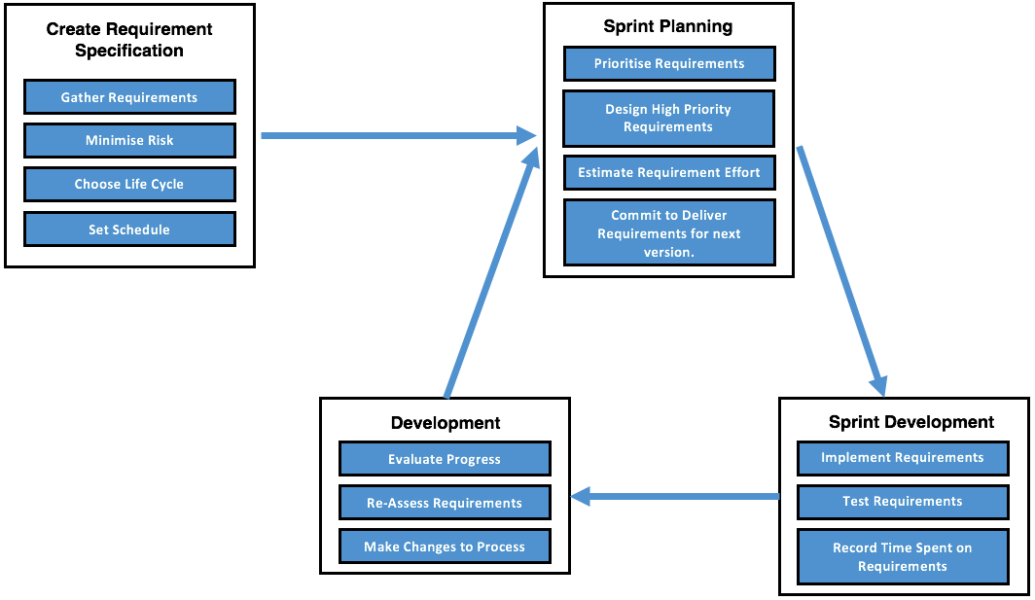
STRATEGY
Lifecycle Influences:
Spiral – MVP requirements will be done first as they are the most risky.
Waterfall – To further reduce risk the initial requirements gathering and design of the project has been somewhat substantial.
Scrum – Scrum like iterative process will be followed after the initial specification has been created.

Slide 12







PLATFORM
Server
Client
Notes:
Images from:
https://dab1nmslvvntp.cloudfront.net/wp-content/uploads/2016/04/1459870313PHP-logo.svg.png
https://www.rosehosting.com/blog/wp-content/uploads/2016/03/build-nginx-with-pagespeed-module.png
https://images.g2crowd.com/uploads/product/image/1474484512/postgresql.png
https://upload.wikimedia.org/wikipedia/commons/thumb/4/4a/Debian-OpenLogo.svg/2000px-Debian-OpenLogo.svg.png
http://logos-download.com/wp-content/uploads/2016/09/React_logo_wordmark.png
https://www.planet-source-code.com/vb/2010Redesign/images/LangugeHomePages/HTML5_CSS_JavaScript.png
http://polikin.github.io/presentation/compass/assets/images/sass-compass-logo.png

Slide 13
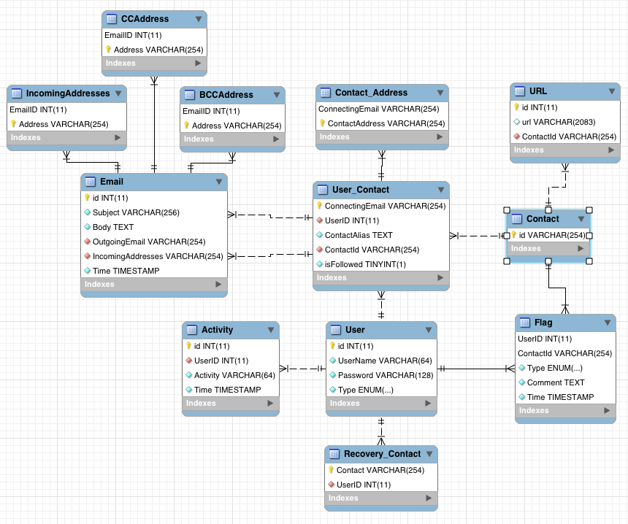
Database Scheme
Three main entities:
Users – Have multiple connecting emails.
Contacts – Connect to the user through a connecting email address.
Emails – Are sent from/to connecting emails.
Notes:
Three main entities User, Contacts & Emails
Reversed engineered from MySQL but can be easily changed

Slide 14
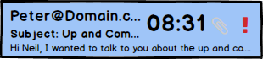
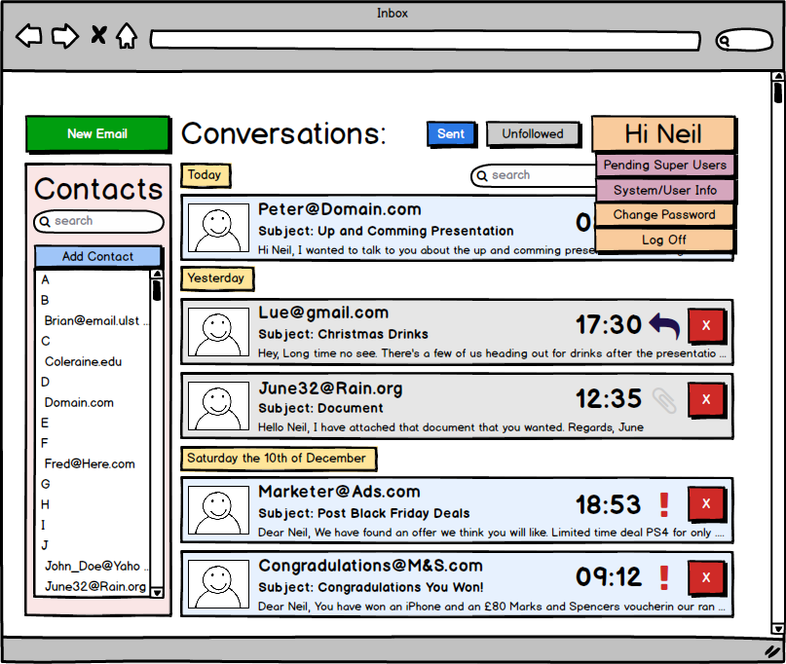
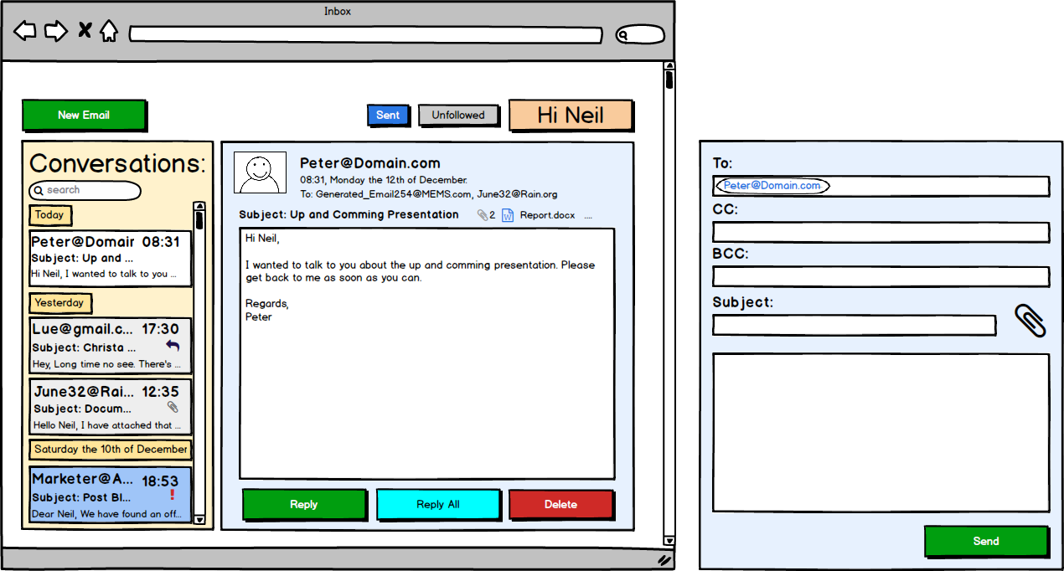
User Interface
Notification
Inbox
View Mail
Send Mail

Slide 15
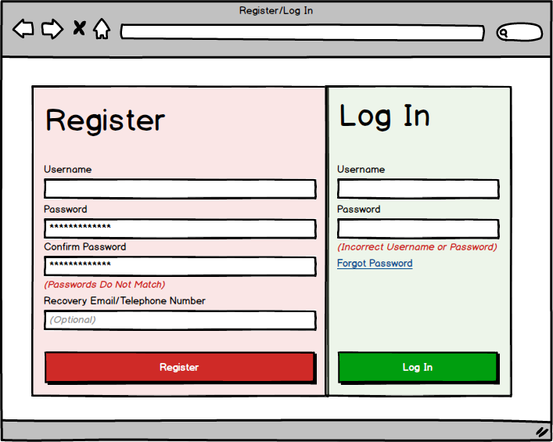
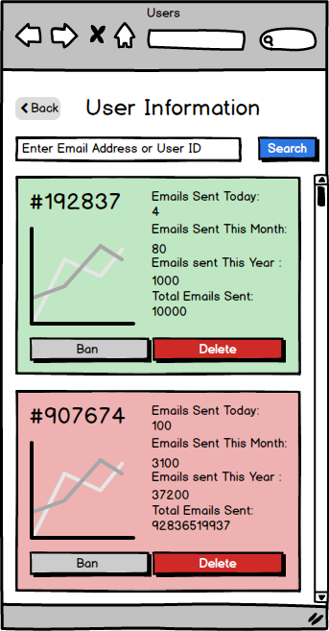
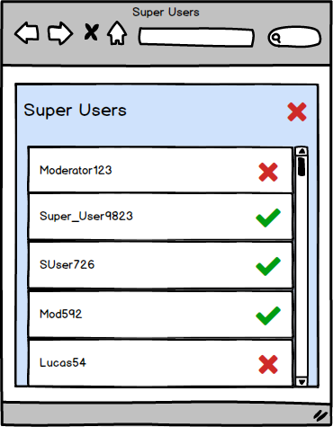
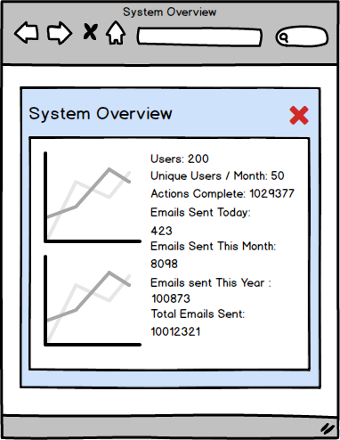
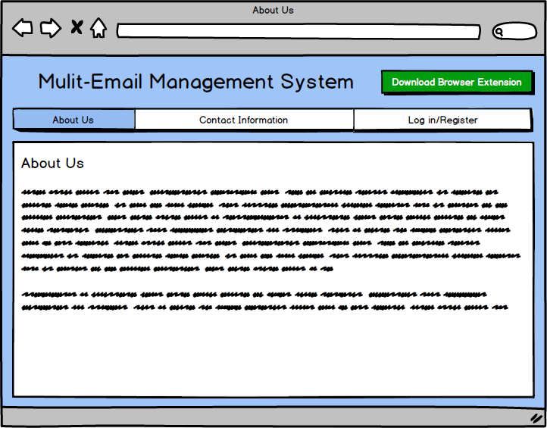
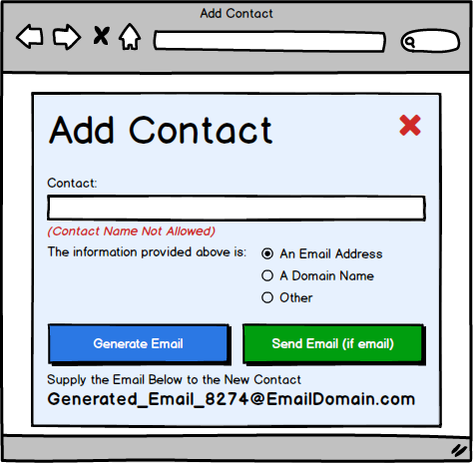
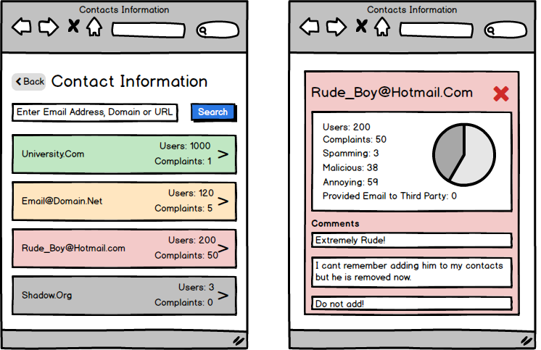
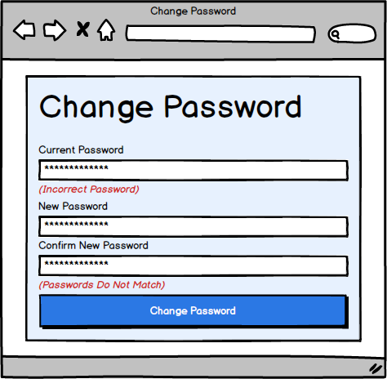
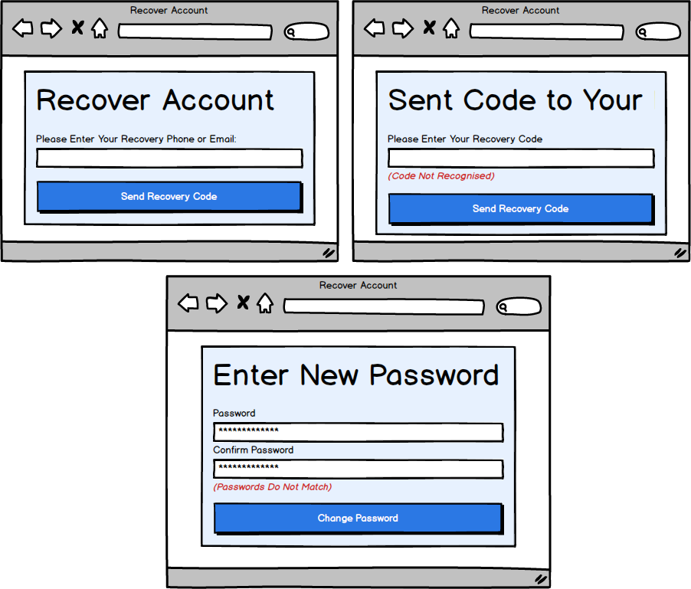
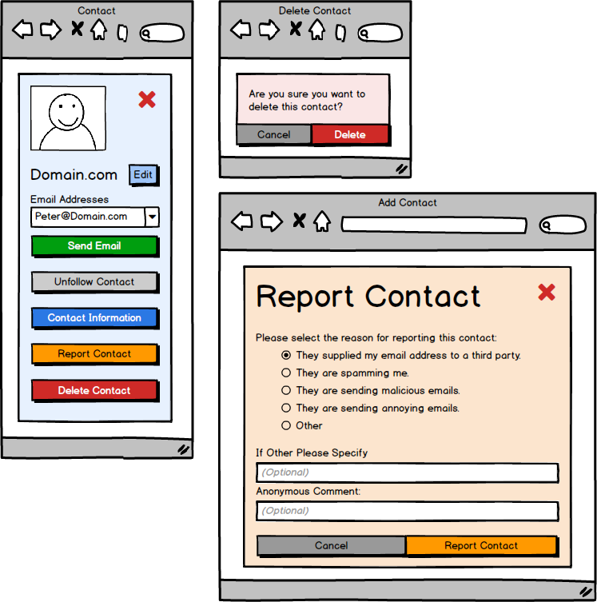
User Interface
Register/Log In
Admin Tools
Home Page
Manage Contacts
Password Management

Slide 16
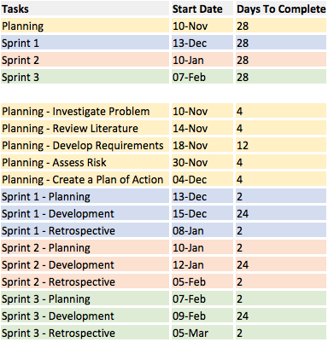
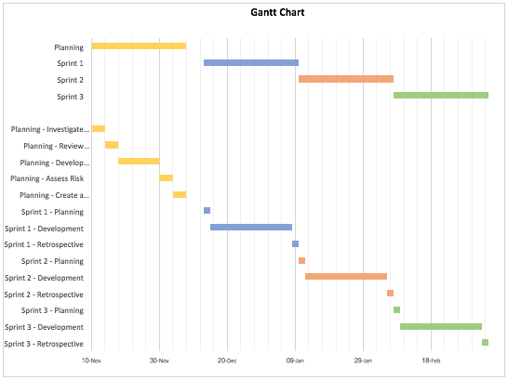
SCHEDULE

Slide 17
Questions

